Slide 1
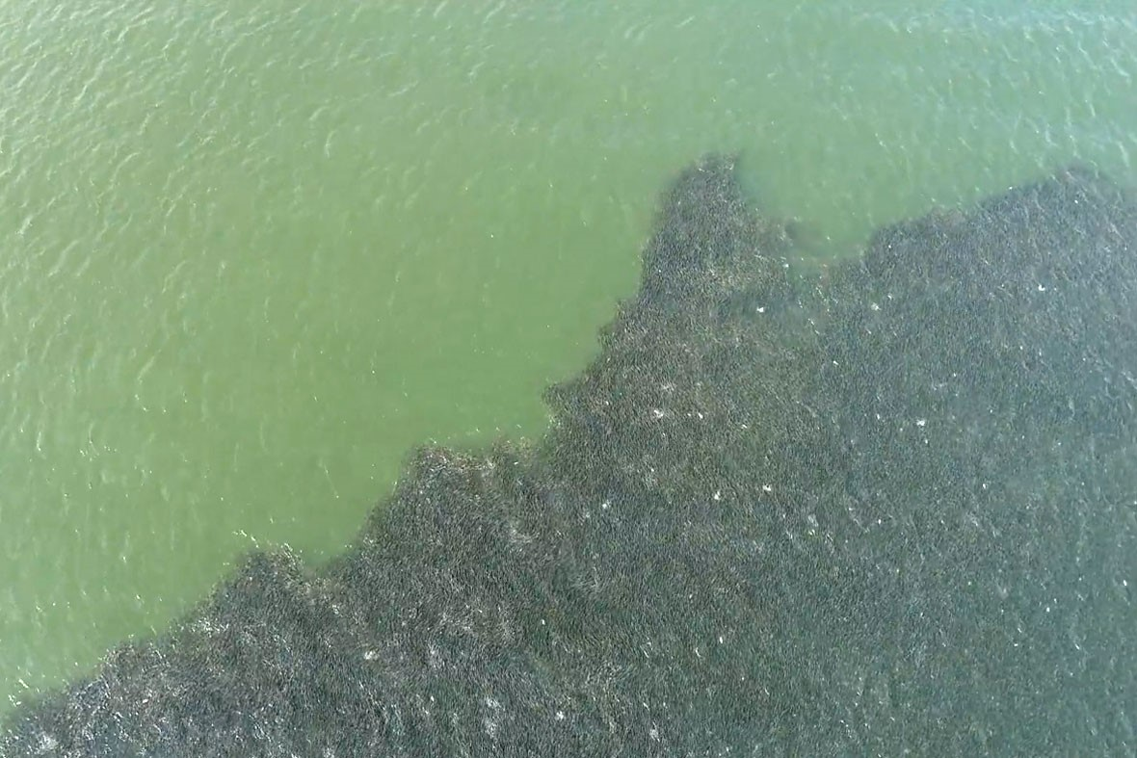

Fisheries spatial ecology
Katie Lankowicz
31 May 2023

Slide 2



About me
BS – Stony Brook University, 2012 – 2016
PhD – University of Maryland Center for Environmental Science/ University of Maryland, 2016 – 2022
Postdoc – GMRI, 2022
Notes:
Started out as bio major intending to be a teacher, wasn’t very excited about it
Took a course on intersection of marine science and waste management (Long Island/ NYC has huge problems with this) and was super interested
Grad school as video game tokens
Thought critically about what I was interested in during my last semester – thing that caught my attention was spatial-temporal mismatch of larval fish and prey items affecting the population size
Was accepted to UMD but couldn’t find an advisor, started working as a gardener
Lucked out when Hongsheng found me

Slide 3
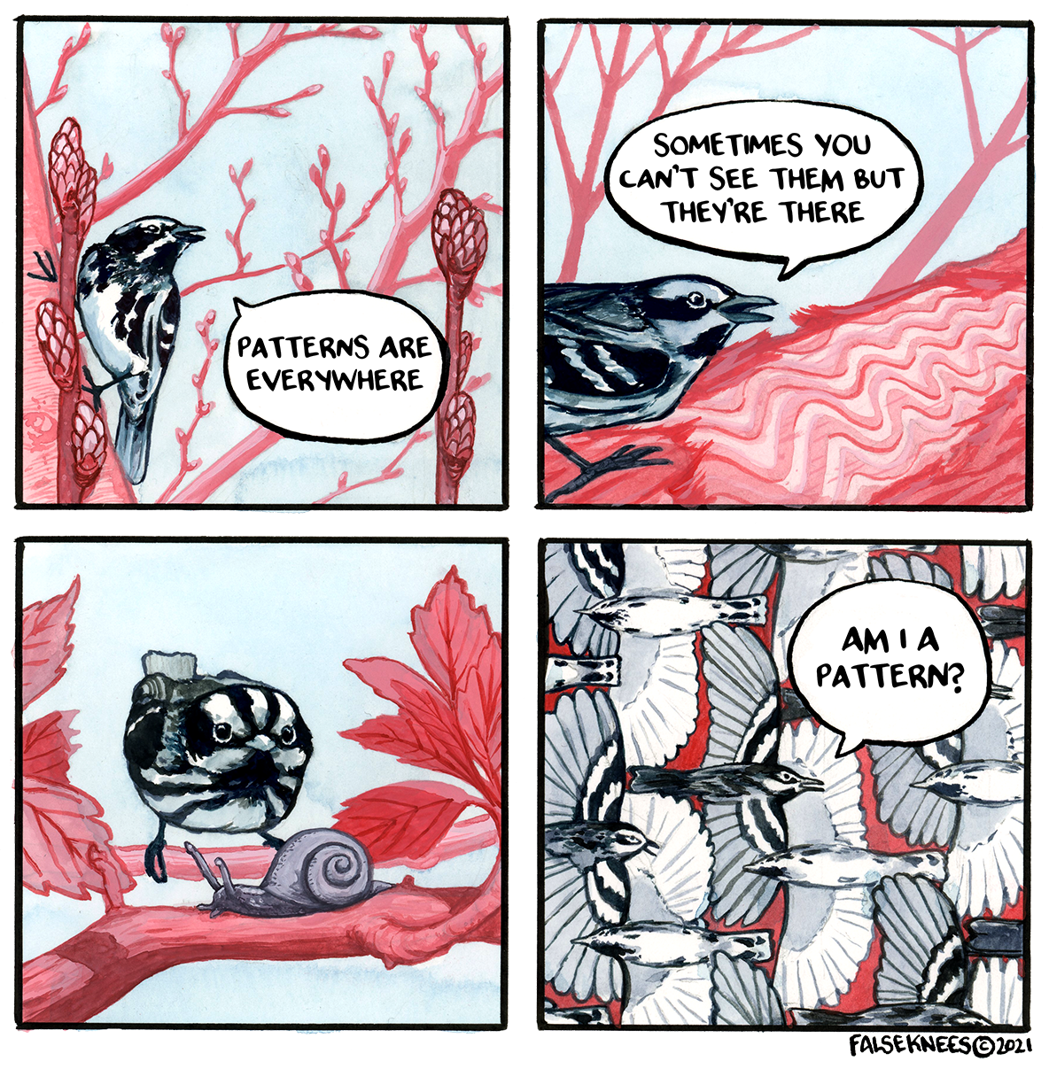
Spatial Ecology
Organisms are often distributed in identifiable spatial patterns within their habitats
Patches or gradients
Something is causing these patterns
Underlying driving processes
Notes:
Underlying: species interactions, environmental factors like resource distribution, randomness

Slide 4
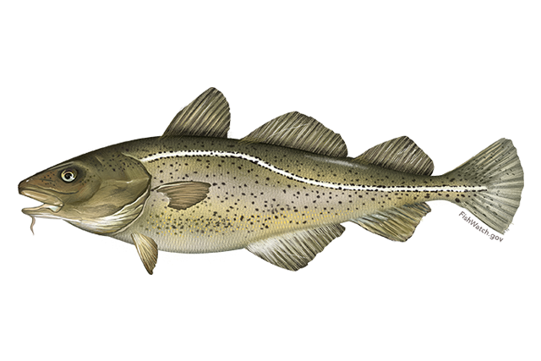
What am I working on now?
How do Atlantic cod utilize different habitat types?

Slide 5
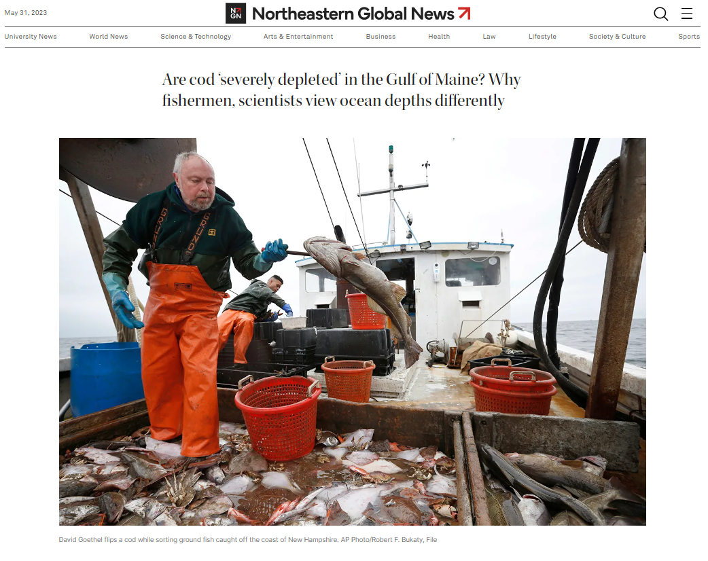
Atlantic cod
Atlantic cod
Economic and cultural importance to North Atlantic
Many stocks collapsed in the 1990s, recovery efforts dramatically reduced fishing effort
Commercial fishers and fisheries scientists disagree on the status of the population

Slide 6
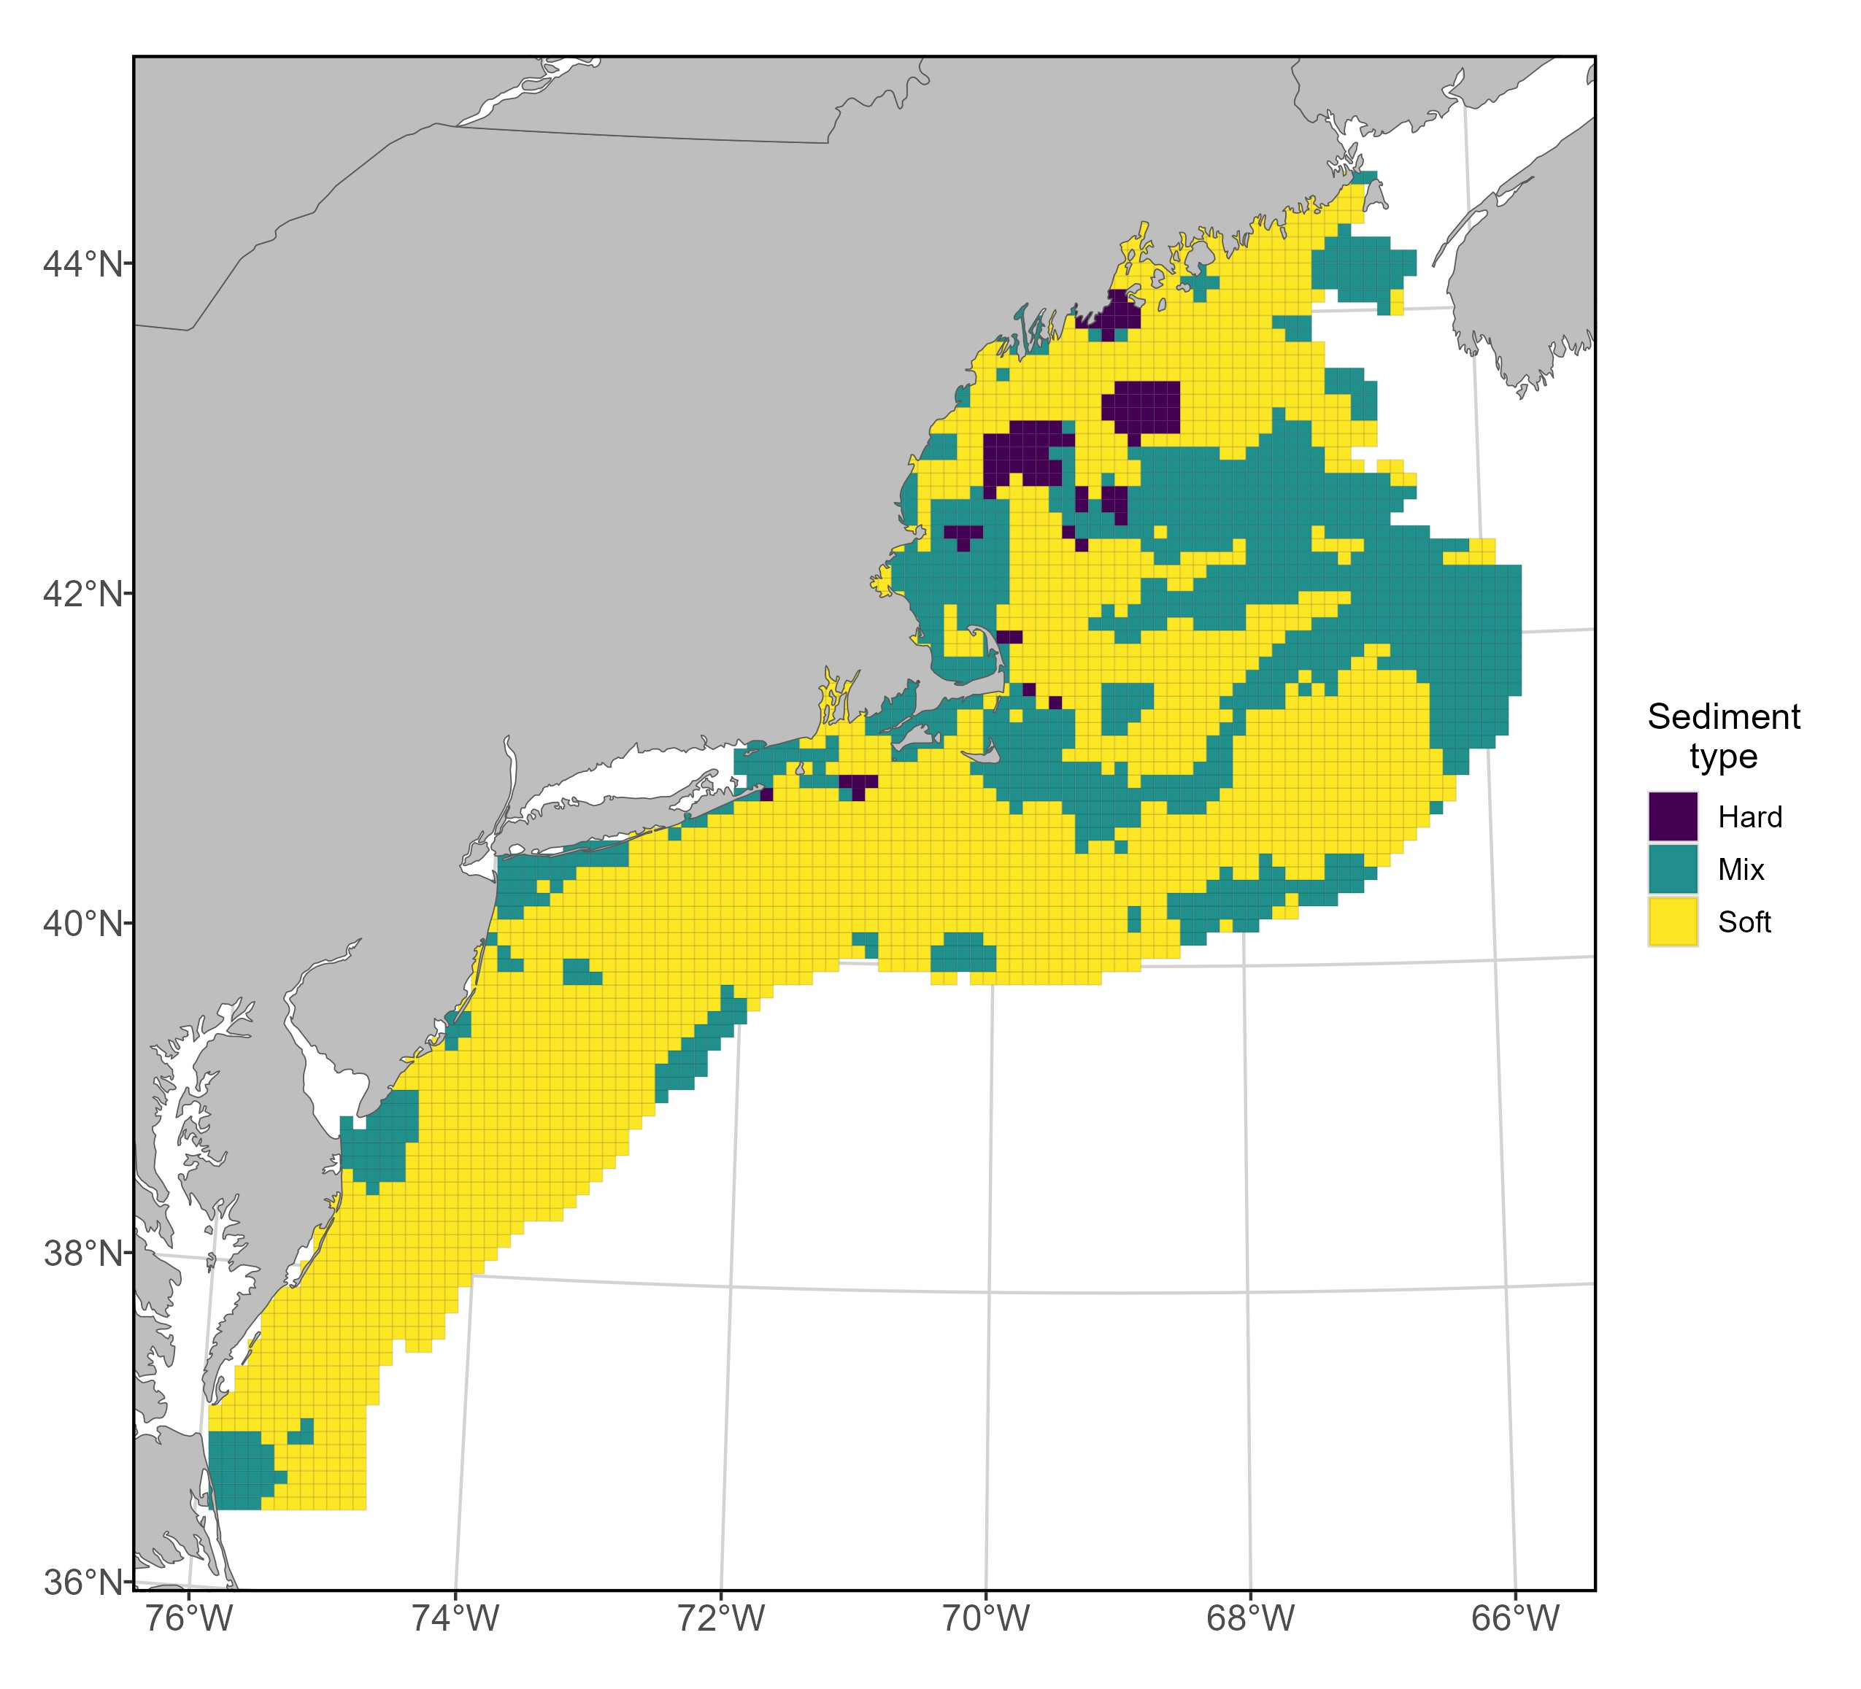
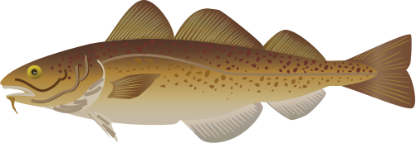
Spatial heterogeneity

Slide 7
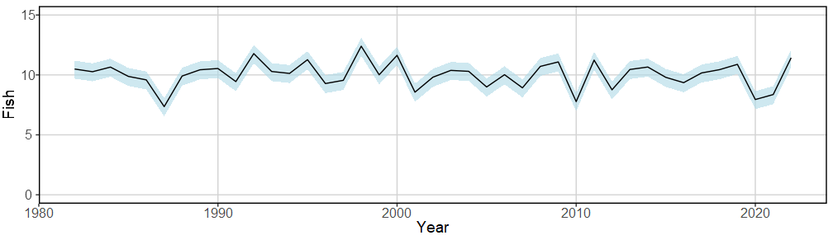
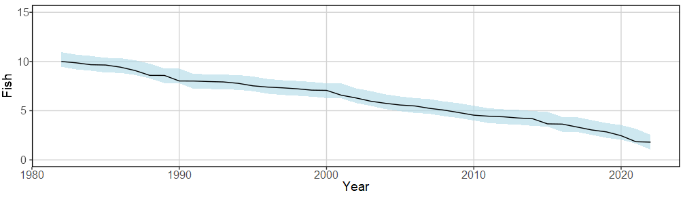
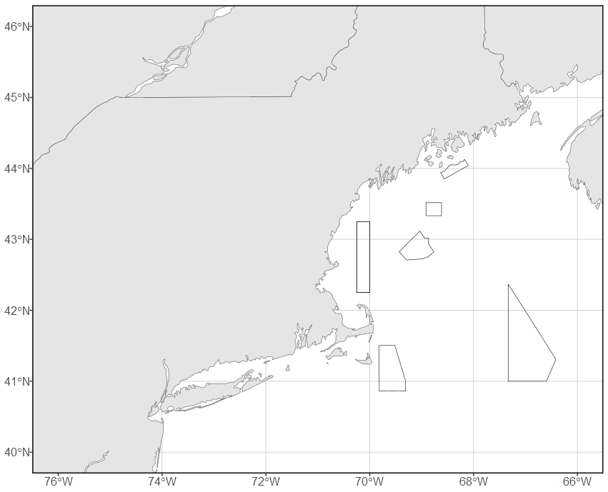
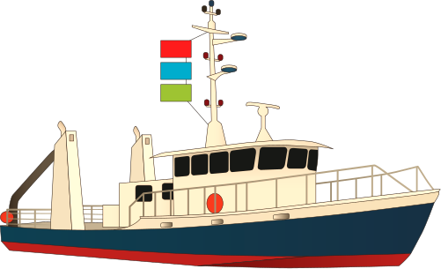
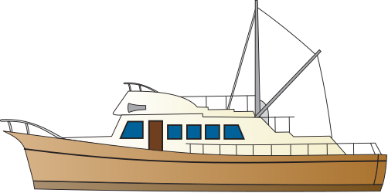
Spatial density perceptions
Commercial Fishing
Fishery-independent
surveys

Slide 8

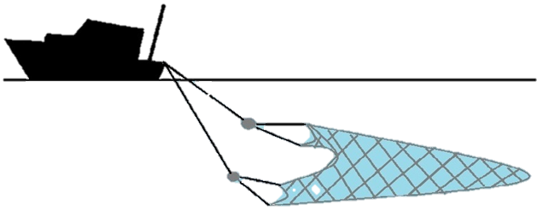
Assessing cod abundance

Slide 9
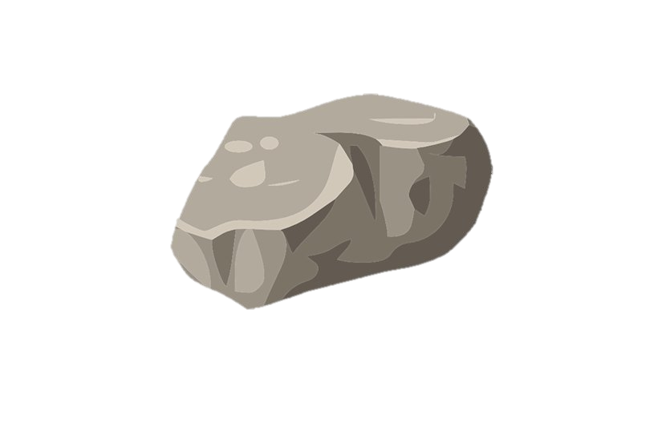
Assessing cod abundance

Slide 10
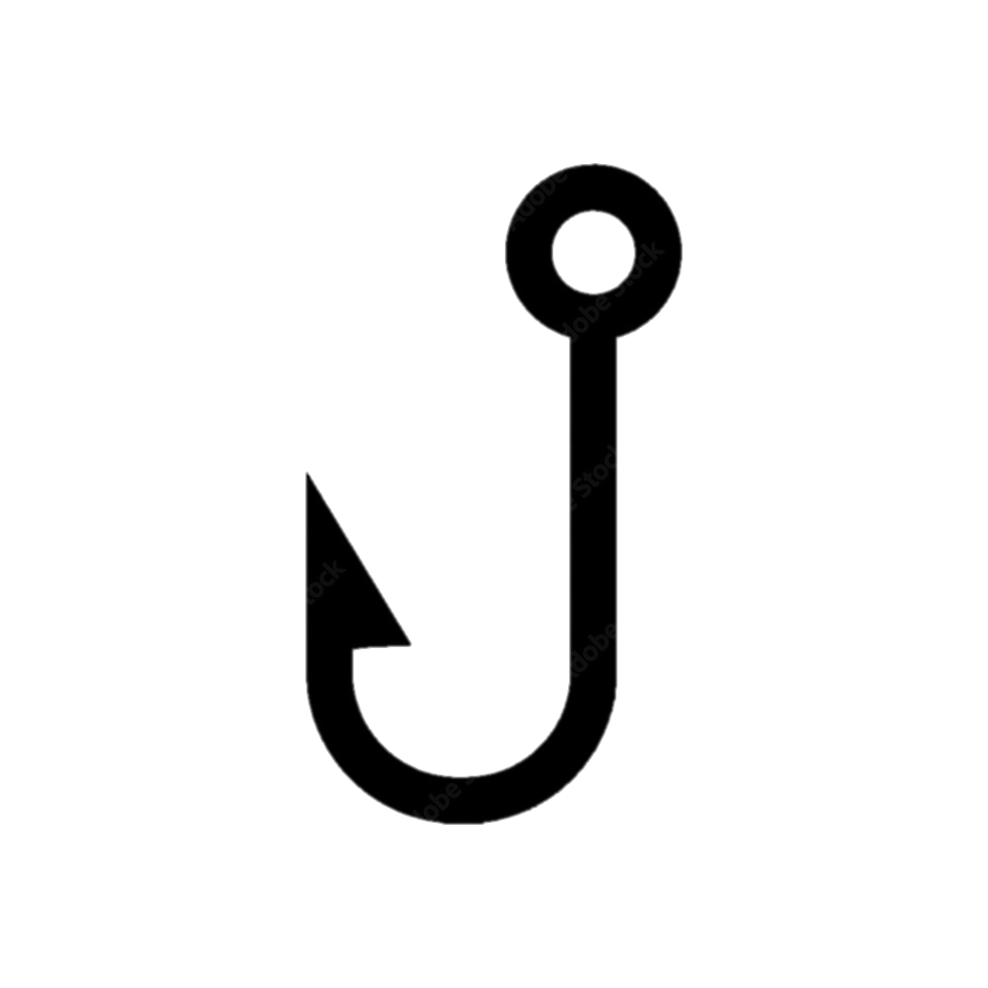
How do we fix this?

Slide 11
Approach
Vector Autoregressive Spatio-Temporal Model (VAST)
Designed to estimate spatial variation in density, with the goal of habitat associations and estimations of total abundance in one or more time steps.

Slide 12
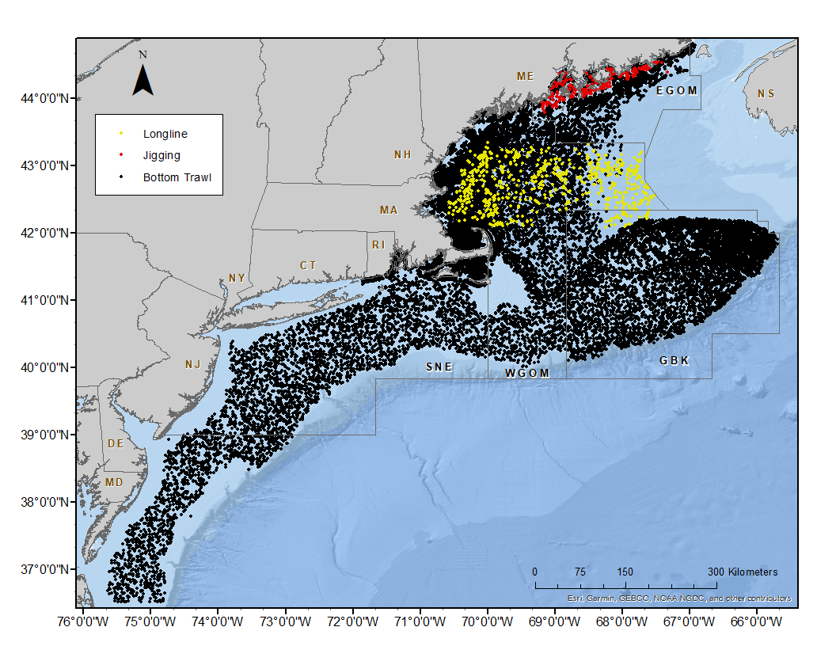
Input data
11 surveys
Multiple gear types
40 years (1982 – 2022)
Wide spatial coverage

Slide 13


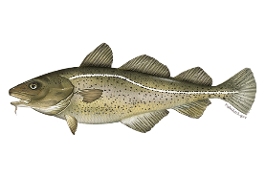
Input data
Seasons
Size classes
Fall
Spring
Small
(< 40cm)
Medium
(40-70 cm)
Large
(>70 cm)

Slide 14
Input data
Sediment type: hard, soft, mixed
Rugosity
Elevation change over horizontal distance
Bathymetry (depth)
Bottom temperature
Climate indices: NAO, AMO

Slide 15
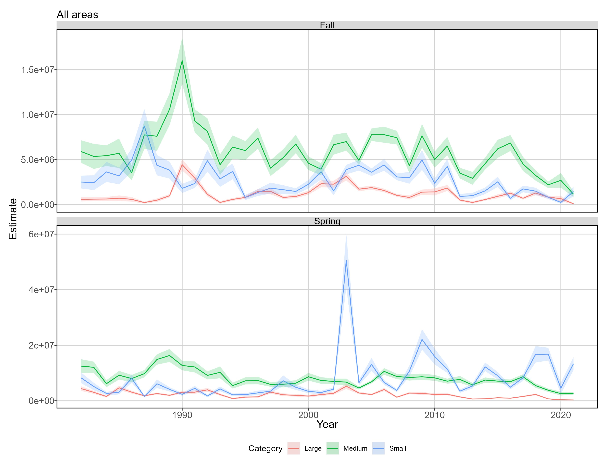
Results: indices of abundance

Slide 16
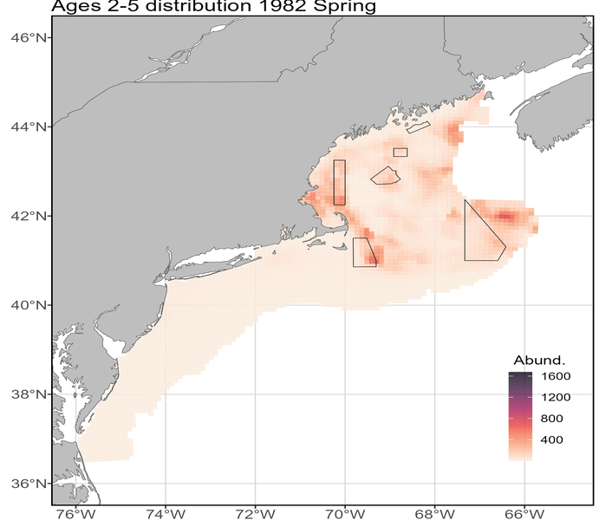
Results: spatio-temporal density
Abund.
High
Low

Slide 17
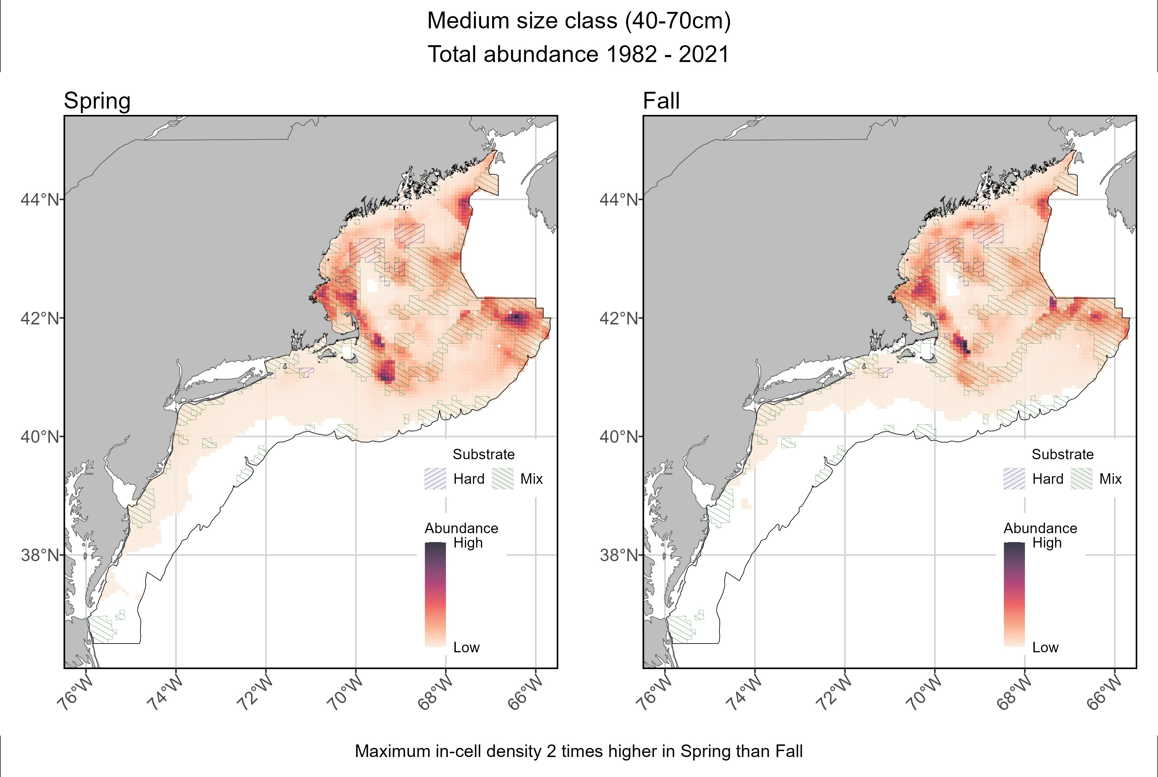
Results: spatial density

Slide 18
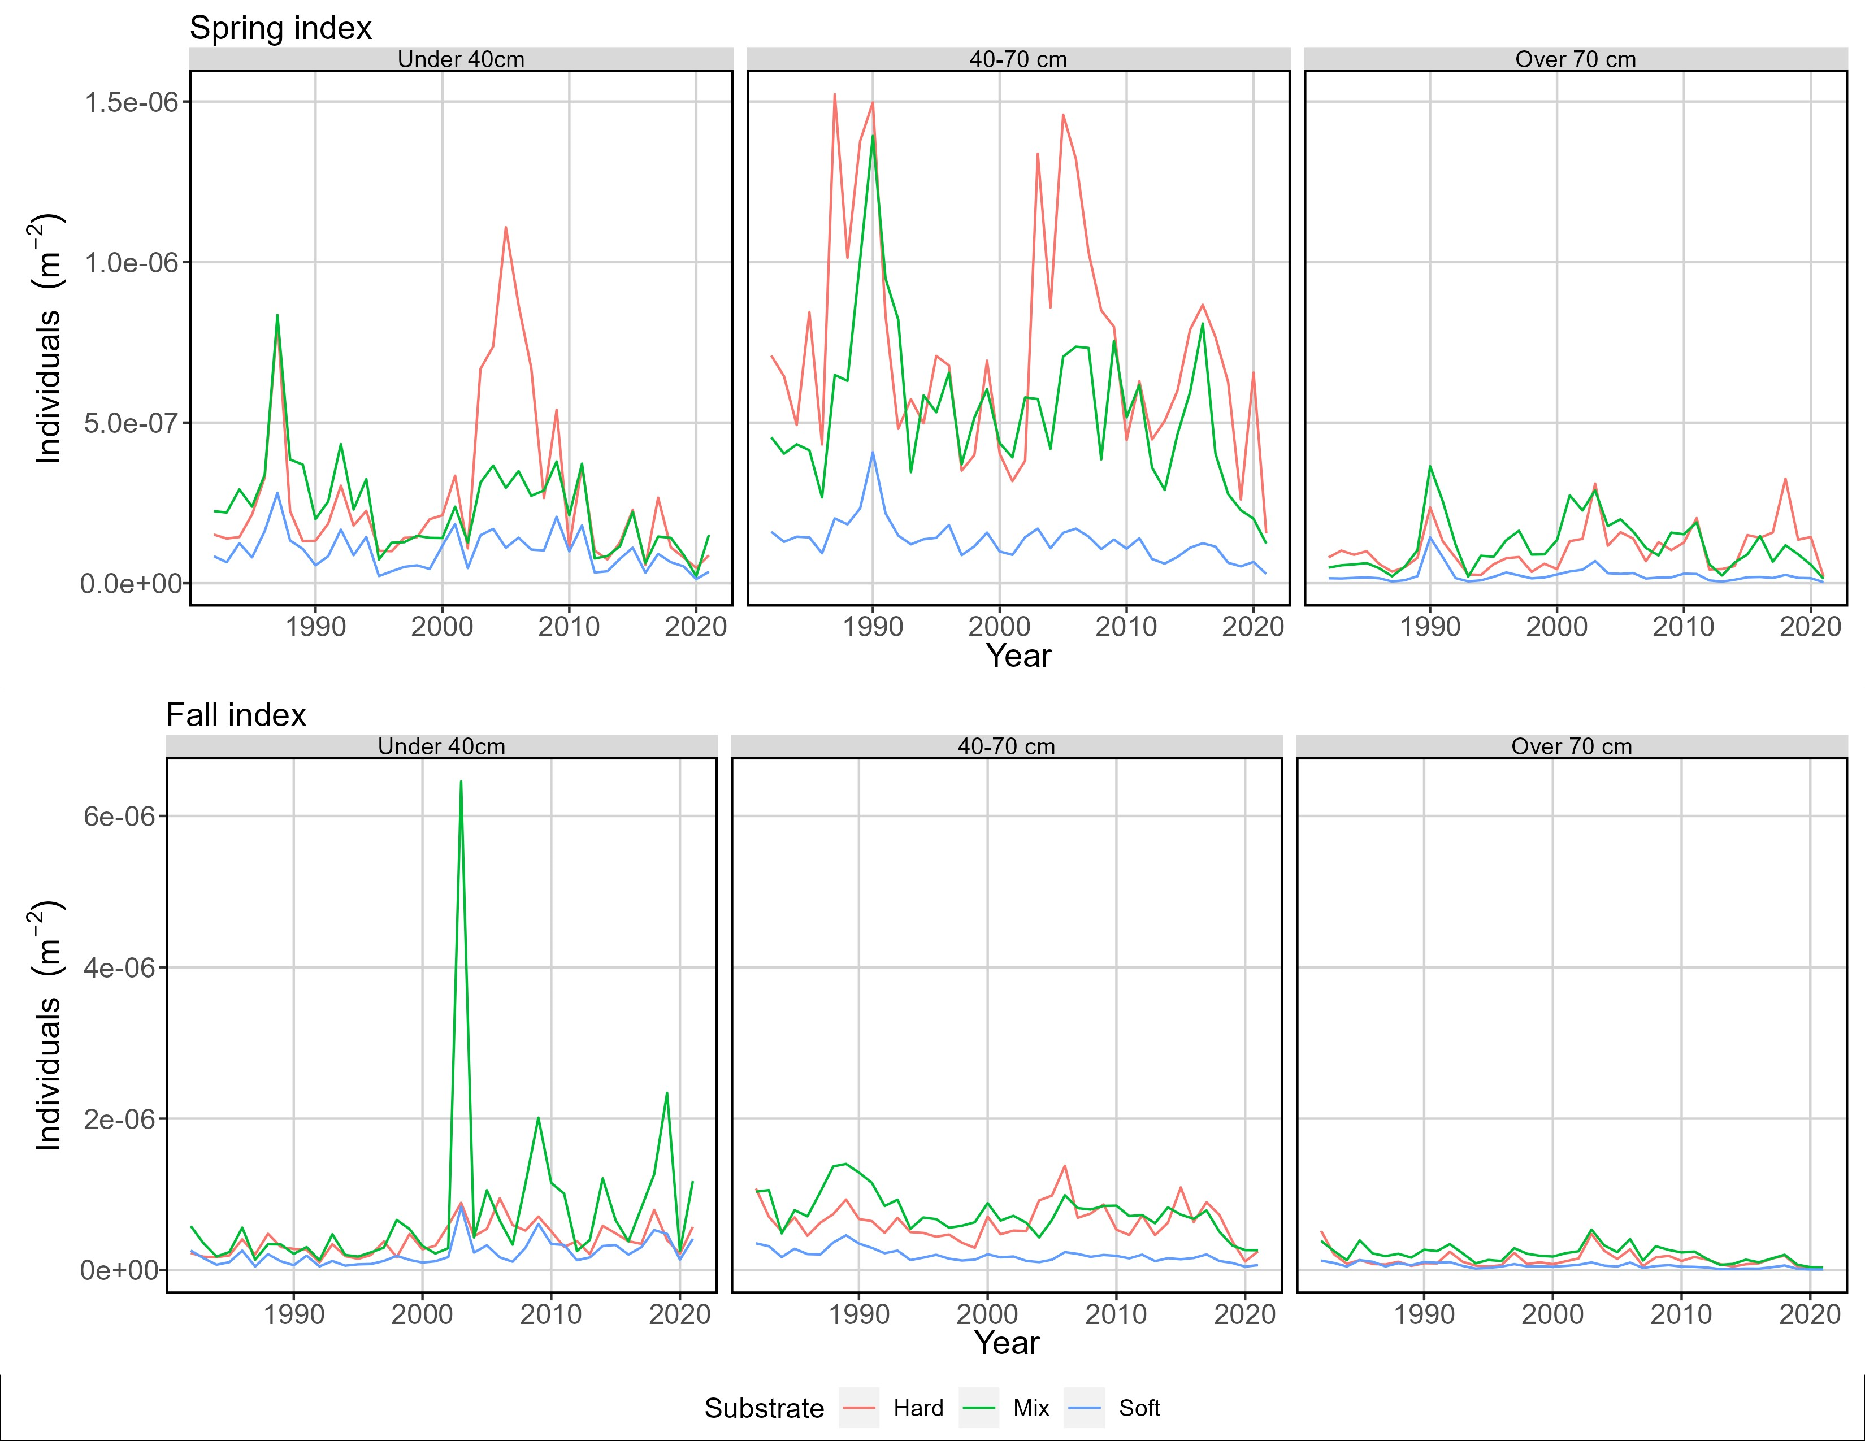
Results: sediment-based density

Slide 19
Expected impacts
Build consensus between fishery stakeholders and fisheries scientists.
Improved understanding of cod abundance in areas not commonly sampled using bottom trawl stratified random sampling.
Contribute to the 2023 Atlantic Cod Research Track Stock Assessment.
Proof of concept for future stock assessments and/or other species.

Slide 20
Future aspirations
I’ll be here for the next two years!
Land a tenure-track position
Research and teaching
Research directions:
Concrete linkages of habitat ecology, spatial ecology, and climate change
Phenological shifts and spatio-temporal mismatch of resources
Cascading effects of wind energy development on nearshore ecosystems
Modeling the development and maintenance of fish schooling patterns

Slide 21
Thanks!
klankowicz@gmri.org
End of research hallway, across from the stairwell

Slide 22
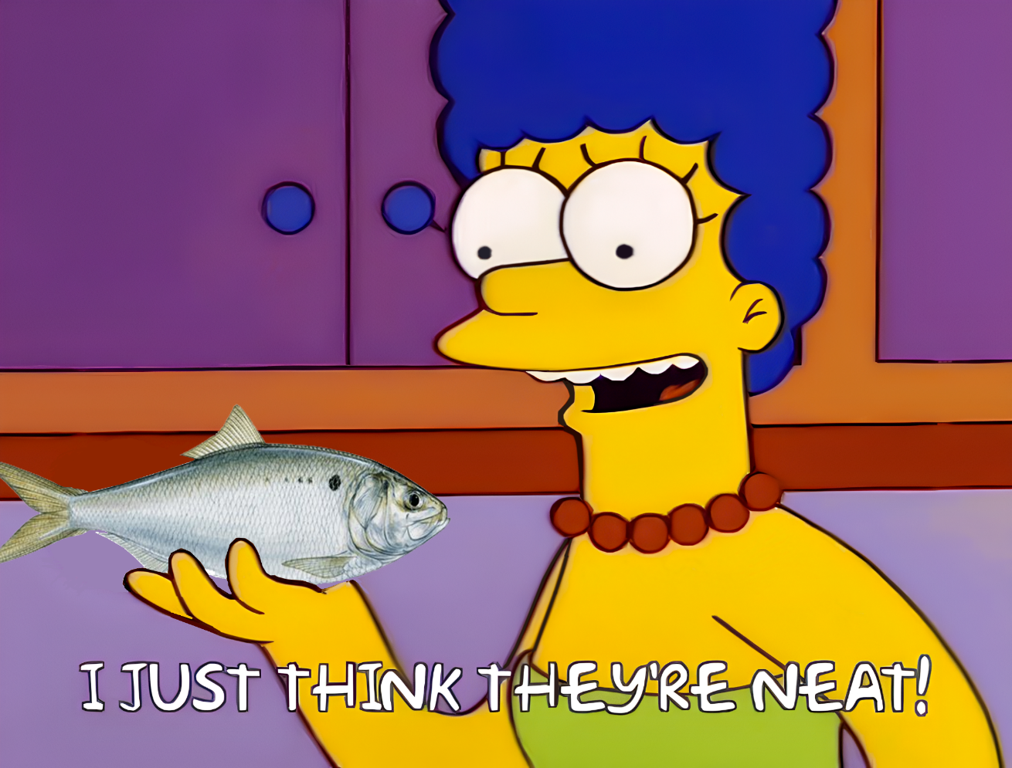
What’s the use?
What’s the use?
Connectivity between environmental conditions and species distribution in heterogeneous spaces
Improve predictive ability of species abundance and distribution

Slide 23
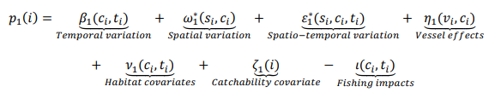
Model structure
Step 1: For each category, model encounter probability at every spatial location and time step
Step 2: For each category, model positive catch rate (abundance) at every spatial location and time step based on the calculated encounter probability

